Slide 1
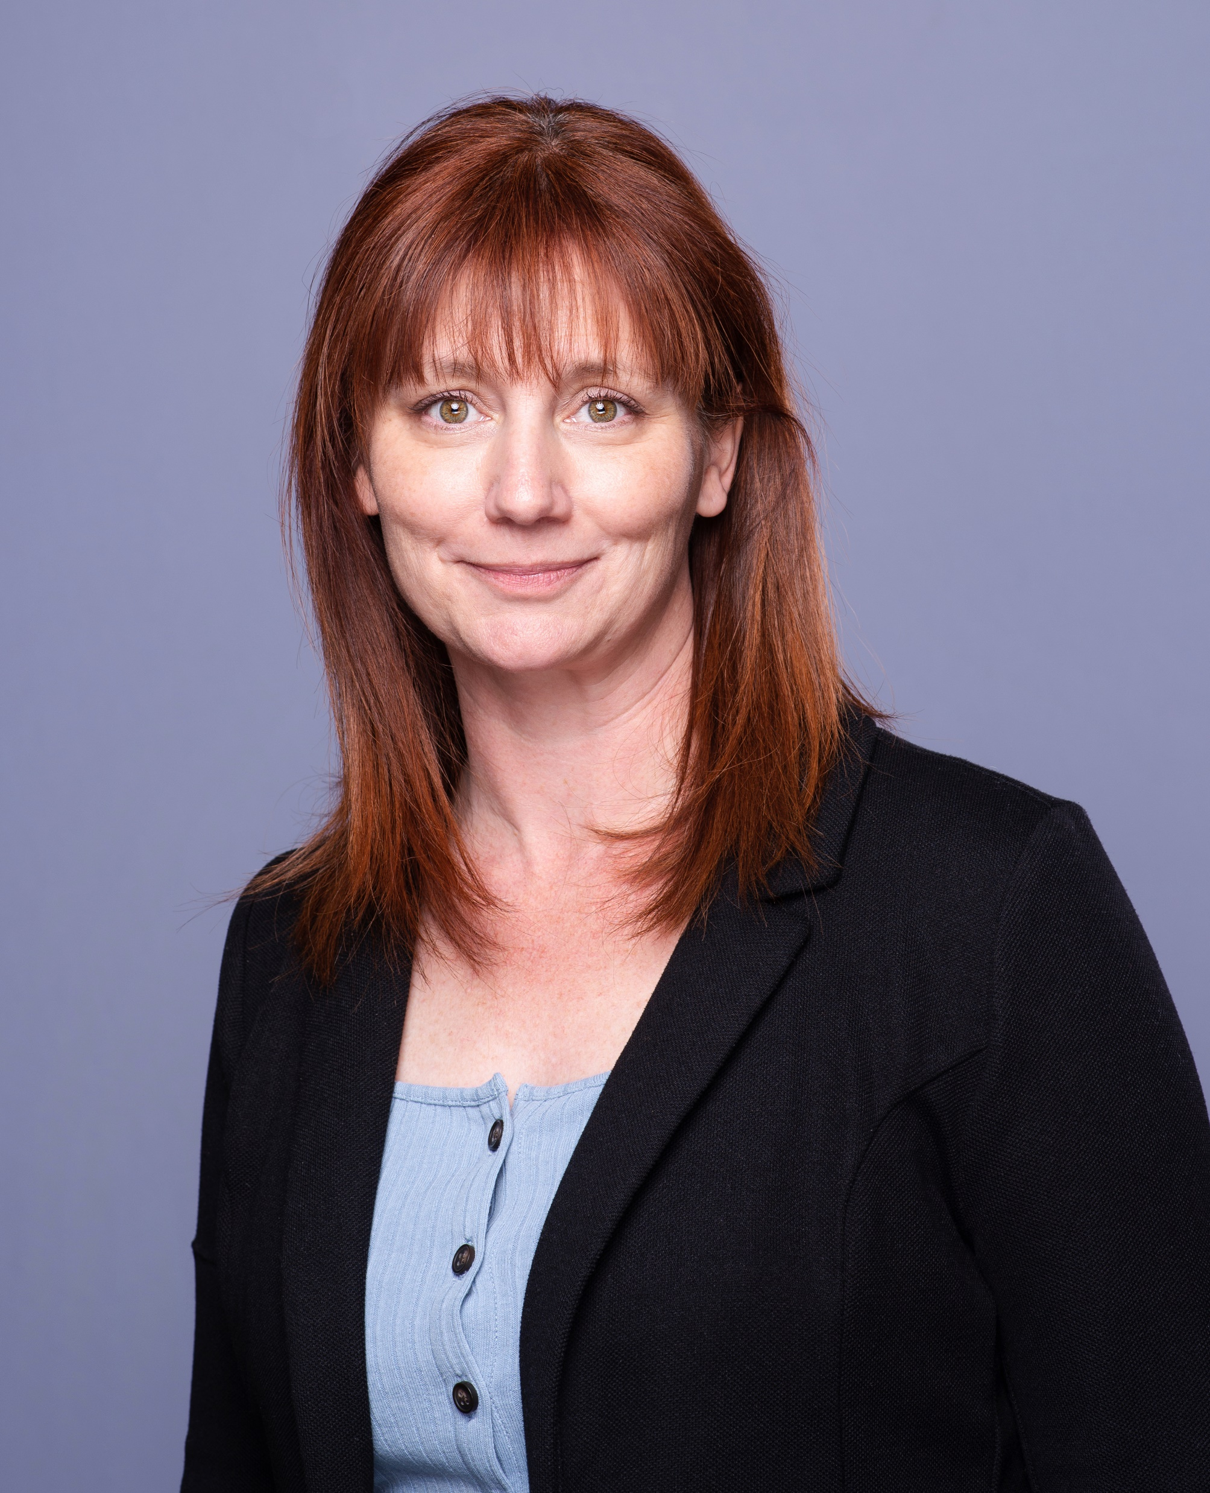
ECC Safety Tip
Value Every Voice
ECC Safety Committee
Prepared by Crystal Zammit, AMECO
May 2024

Slide 2
Value Every Voice
Overview
In May, Construction Safety Week highlighted that by valuing every voice, we can elevate a safety culture from compliance to fostering an engaged and empowered workforce.
This workforce strategizes together, trusts each other, and thrives with individuals taking pride and ownership over the safety of everyone in the office and on a jobsite.

Slide 3
Value Every Voice
Who is the Engaged and Empowered individual?
A person who asks follow-up questions if safety instructions are unclear and ensures that others understand them as well.
Has the confidence to be a leader, leads by example and encourages safe behavior of others.
Has the courage to STOP WORK and challenge unsafe acts or conditions.
Is aware of their surroundings and alert to changing conditions; they communicate changes to their team.
Actively participates in planning discussions to identify hazards and safeguards and familiarize themselves with the safety aspect of the task.
Is always accountable and understands their actions could have positive and negative consequences.
Notes:
Presentation notes
If you are presenting this tip, you might read or have an attendee read the Overview.
The questions under ‘Questions to consider’ could be presented and allow time for participants to discuss and briefly share their thoughts before moving to the next slide.

Slide 4
Value Every Voice
Questions to consider
What channels are available for employees to communicate safety issues?
Are employees from all levels and departments encouraged to participate in safety walks and discussions?
How often are employee suggestions recognized and implemented into safety protocols?
Do employees feel that their input genuinely makes a difference in safety outcomes?

Slide 5
Value Every Voice
Key Strategies
Safety Audits and Walkthroughs: Involve a diverse group of employees for routine safety audits and walkthroughs of the jobsite and offices to identify and discuss potential safety hazards. Create opportunities for less experienced team members to ask questions and note concerns, there is value in a fresh perspective.
Safety Committees: Establish safety committees that include representatives from different departments to discuss and address safety concerns collectively. Track and communicate success stories by using a “you asked / we did” program.
Open-Door Policy: Ensure that management maintains an open-door policy for all employees to discuss safety and communicate concerns at any time.
Feedback Loop: Create a system where employees receive feedback on their safety suggestions, showing that their input is valued and considered. Dedicate time during safety meetings to discuss concerns raised and action taken.

Slide 6
Value Every Voice
Valuing every voices is about creating an environment where everyone feels empowered to contribute, ensuring that safety becomes second nature.
How can we foster a space where every team member not only feels heard but is actively shaping the safety landscape?
Let's commit to making safety a shared responsibility, building trust and collaboration every step of the way.

