Slide 1
ECC Safety Tip
Family Safety: Staying Safe with Summer Activities
Summer activities are a great way to enjoy life, but it's important to be aware of the potential risks. This presentation will cover some key safety tips to keep you and your loved ones safe.
ECC Safety Committee
Daniel Brogden, PEMEX Deer Park Refinery, Turnaround Event Manager
June 2024

Slide 2
Safety Topics*
Heat Exhaustion: Staying Safe in the Sun
Swimming Safety: A Vital Reminder
Pool Chemical Storage: Handling with Care
Boating Safety: Navigating Safely
Fireworks Safety: Celebrate Responsibly
*Each topic can be shared as a stand-alone safety tip, or they could all be shared in one safety session.

Slide 3
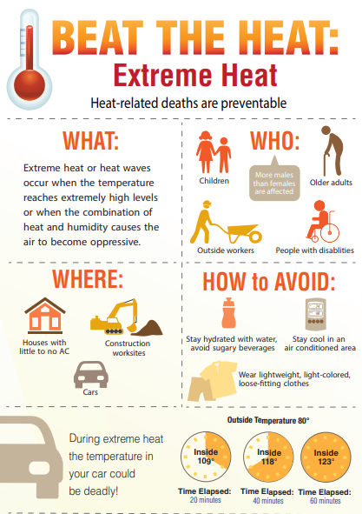
Stay Hydrated: Drink plenty of water before, during, and after activities. Avoid sugary or alcoholic beverages, as they can cause dehydration.
Take Breaks: Schedule regular breaks in a cool or shaded area. Resting allows your body to cool down and recover.
Choose Cooler Times: Plan outdoor activities during the cooler parts of the day, such as early morning or late evening.
Wear Appropriate Clothing: Opt for lightweight, loose-fitting clothing that allows sweat to evaporate. Light colors can also help reflect heat.
Know the Warning Signs: Be aware of the symptoms of heat exhaustion, such as heavy sweating, weakness, dizziness, nausea, and headache.
Modify Intensity: Adjust the intensity of your activities based on the temperature and your fitness level. Don’t push yourself too hard in hot weather.
Protect Yourself from the Sun: Wear a hat and apply sunscreen to prevent sunburn, which can affect your body's ability to cool itself.
Monitor Children and Elderly: Keep an eye on children and older adults who may be more vulnerable to heat-related illnesses.
Seek Medical Attention if Needed: If someone shows signs of severe heat exhaustion (e.g., confusion, fainting, high body temperature), seek medical help immediately.
Family Safety: Staying Safe with Summer Activities
Notes:
.

Slide 4
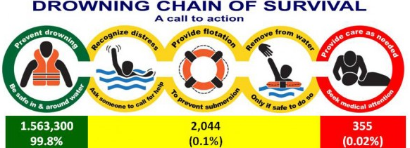
Swimming Safety: A Vital Reminder
Tips for Prevention?
Swimming lessons can reduce the risk of drowning. Children who have had swimming lessons still need close and constant supervision when in or around water.
Home swimming pools need a four-sided fence at least four feet high with self-closing/latching gate that fully encloses the pool and separates it from the house. The fence needs a.
"Floaties," arm bands, or water wings do not prevent children from drowning and can easily slip off, especially when kids jump into the water. A U.S. Coast Guard-approved life jacket is more protective.
These actions will help your family avoid emergencies – and help you respond if an emergency occurs:
Paying close attention to children or weak swimmers you are supervising in or near water.
Knowing the signs that someone is drowning.
Knowing ways to safely assist a drowning person
Knowing CPR and first aid
More Helpful Info:
Water Safety for Parents and Caregivers (redcross.org)
Did You Know?
Every year in the United States there are an estimated:
4,000 fatal unintentional drownings - An average of 11 drowning deaths per day.
8,000 nonfatal drownings - Average of 22 nonfatal drownings per day.
Drowning is the leading cause of death for children 1 to 4 years old, and the second leading cause of unintentional injury death for children 5 to 14 years old.
About 100 people drown from rip currents along U.S. beaches each year, according to the United States Lifesaving Association. And more than 80 percent of beach rescues annually involve rip currents.
Family Safety: Staying Safe with Summer Activities

Slide 5
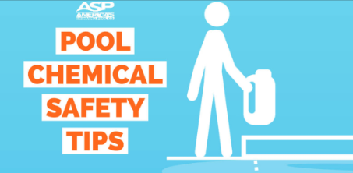
Pool Chemical Storage: Handling with Care
When storing pool chemicals, it's crucial to be aware of how different chemicals can interact and the potential hazards that may arise, especially when they are stacked or stored in close proximity. Here are some specific tips regarding stacking pool chemicals and what can happen if not done properly:
Read the Labels for each chemical you use.
Ensure all chemical containers are tightly sealed when not in use to prevent leaks and contamination.
Pool chemicals should be stored in a cool, dry, and well-ventilated area. Avoid storing them in direct sunlight or near heat sources, as heat can cause chemicals to degrade or react dangerously.
Store different types of chemicals separately and organize them in a way that prevents accidental mixing. Chemicals should ideally be stored in their original containers.
Use Proper Containers and ensure they is clean, dry, and compatible with the chemical. Avoid using food containers or containers that previously held other substances.
Store pool chemicals away from any water source, including pools, sinks, or outdoor water features, to prevent accidental contamination or reactions.
Wear appropriate protective gear (gloves, goggles, mask) when handling pool chemicals to protect yourself from exposure.
Have a first aid kit nearby and know how to respond to chemical spills or accidents. Keep emergency contact numbers readily available.
Follow local guidelines for disposing of expired or unused pool chemicals. Do not dispose of them in drains, toilets, or outdoor areas where they can contaminate soil or water sources.
If you have children or pets, ensure pool chemicals are stored in a secure location that is out of their reach. Consider using a locked cabinet or storage container.
Family Safety: Staying Safe with Summer Activities

Slide 6
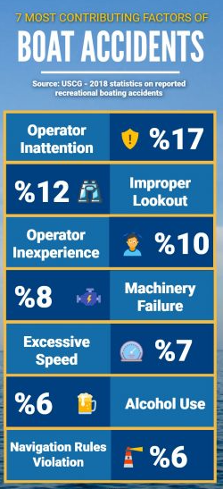
Boating Safety: Navigating Safely
Did You Know?
Thousands of boating accidents occur each year, resulting in injuries and fatalities. It's crucial to be aware of the risks and prioritize safety.
Fatalities: An average of 600 boating fatalities occur each year in the United States.
Injuries: Thousands more are injured in boating accidents each year.
Alcohol: Alcohol is a major contributing factor in many boating accidents
Tips for Prevention?
Check your local weather forecast before setting sail.
Let someone on land know where you plan to go before enjoying a day on the water.
Make sure that every passenger wears a properly fitted life jacket.
Never drink alcohol while operating a vessel.
Take a boating safety course and ensure you are comfortable using your vessel.
Watch for inclement weather.
Beware of your boat's propellers.
Be courteous to others on the water.
Know what to do if someone goes overboard.
Family Safety: Staying Safe with Summer Activities

Slide 7
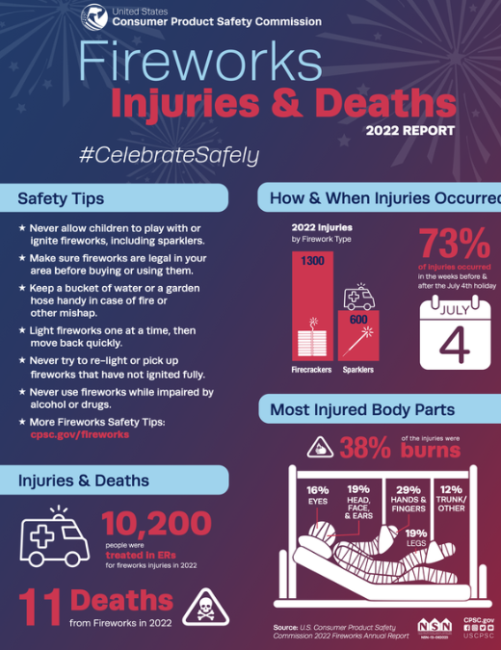
Firework Safety: Celebrate Responsibly
Fireworks can add excitement to celebrations, but they can also be dangerous if not handled properly. Following safety guidelines can help prevent accidents and injuries.
Tips for Firework Safety:
Read Instructions: Carefully read and follow the instructions on each firework.
Have Adult Supervision: Ensure that fireworks are handled by responsible adults.
Use Outdoors Only: Light fireworks in a clear, open area away from buildings, trees, and dry grass.
Keep Water Nearby: Have a bucket of water or a hose ready in case of fire or mishaps.
Light One at a Time: Light fireworks one at a time and move back quickly.
Never Relight Duds: If a firework doesn't go off, wait at least 20 minutes before soaking it in water.
Keep a Safe Distance: Maintain a safe distance from lit fireworks and spectators should stand back.
Dispose Properly: Soak used fireworks in water before disposing of them in a metal trash can.
By following these firework safety tips, you can enjoy a spectacular display while minimizing risks and ensuring everyone’s safety. Celebrate responsibly!
.
Family Safety: Staying Safe with Summer Activities

Slide 8
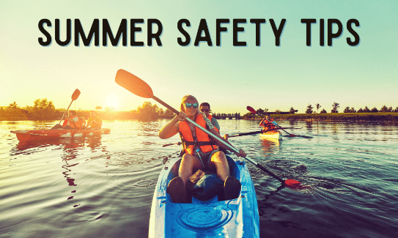
Conclusion: Family Safety: Staying Safe with Summer Activities
As we embrace the joy and freedom that summer brings, it's essential to prioritize safety during all our activities. From swimming and boating to hiking and camping, each adventure presents unique risks that can be mitigated with proper preparation and awareness. By following the tips and guidelines provided in this presentation, families can ensure a fun, memorable, and safe summer for everyone. Remember, safety is a collective effort—stay informed, stay cautious, and most importantly, stay safe. Here's to a summer filled with laughter, exploration, and cherished moments!
Family Safety: Staying Safe with Summer Activities
Notes:
.

